Slide 1
Global Specialty Fulfillment at Amazon
Lucas A. Meyer
Manager, Analytics
Amazon

Slide 2
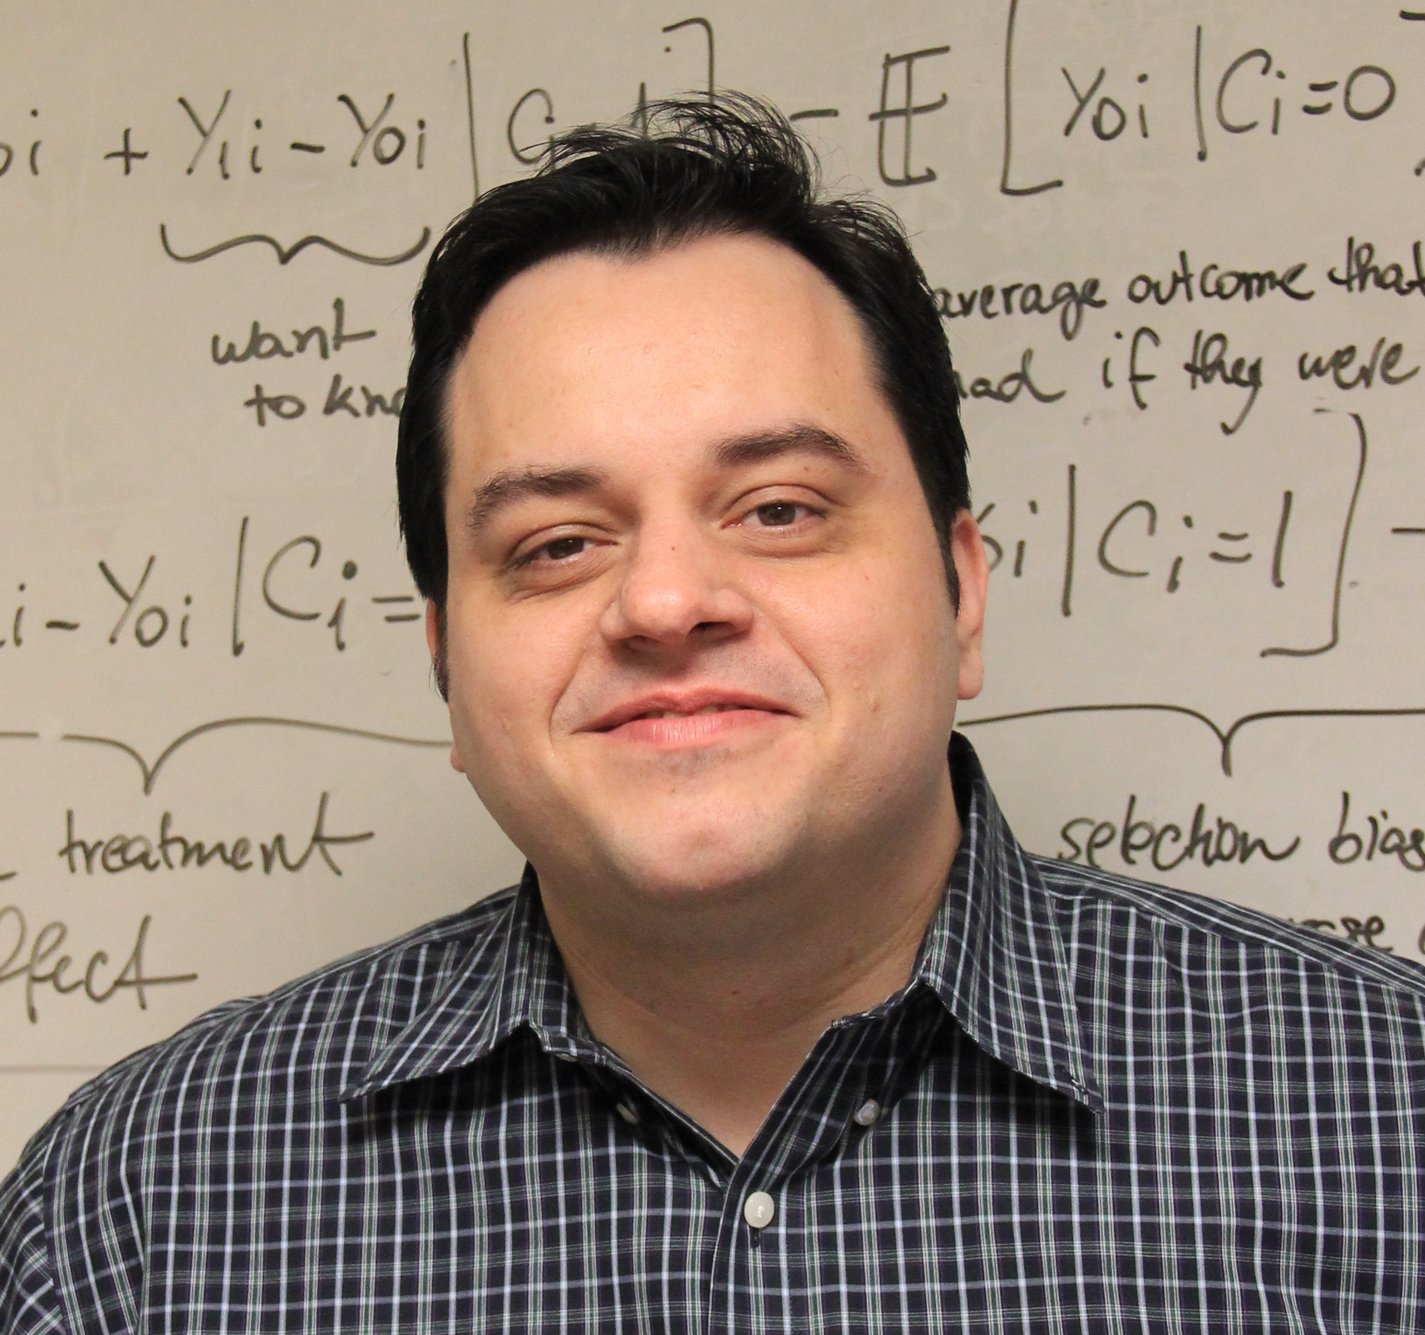
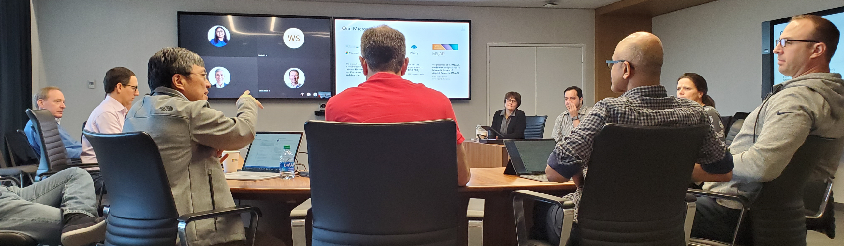
About me
B. Sc. Computer Sciences ‘01 (Universidade de São Paulo, Brazil)
University of Washington TMMBA’10, MSc Finance’14 (ABD)
Microsoft 2002-2020
Amazon since Sep 2020
Twitter: @lucas_a_meyer
LinkedIn: lucasameyer
Email: lucas.meyer@microsoft.com

Slide 3


Example 1:
Predicting errors in invoices
(Microsoft)

Slide 4
Motivation
Enterprise Volume Licensing is a large portion of Microsoft sales…
$52.2B sold in FY18 and $59.1B in FY19
400k invoices in FY18 and 472k in FY19
… but many Enterprise VL invoices are credited and rebilled:
In FY18, 10.8% of the VL invoices were credited and rebilled, representing 18.6% of the amount ($9.7B)
Consequences:
Cost of capital: $54M @ 4%
Over 50k hours of rework cost
Lower customer satisfaction
Day 30 Invoice due
Day 51 Invoice reissued with 30-day terms
Day 81 Reissued invoice is due
Day 0 Invoice issued with 30-day terms
Day 30-51 Find and fix the issues
51 days Delay in cash receipts

Slide 5
Project goals
Fixing root causes of invoice errors was going to take time.
By using machine learning:
Microsoft was able to mitigate the issues by predicting likelihood of errors and shortening the time it takes to correct them
Microsoft was able to identify potential root causes by finding the most predictive features

Slide 6
A complex problem with diverse data:
Our dataset was 1.6M invoices and over 200 variables from the last 5 years.
Customer signs an agreement with Microsoft
Customer issues a purchase order
Microsoft sends customer an invoice
Email/calls between customer and Microsoft
Customer makes a payment
Industry
Geographical location
Direct/through a partner
New/renewed
# of amendments
Manual/electronic PO
# of concurrent POs
# of lines
Amount
Payment Terms
Close to end of year?
Free text, e.g.,
“Hi team, invoice 9877495478 seems to be missing a discount. Expected HWN-00002 - VisioOnlnP1 ShrdSvr ALNG SubsVL MVL unit price 2.36"
Past payment behavior

Slide 7
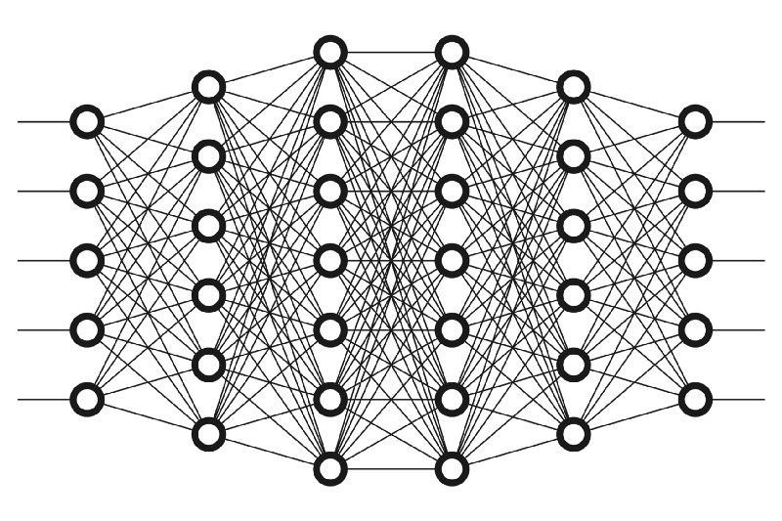
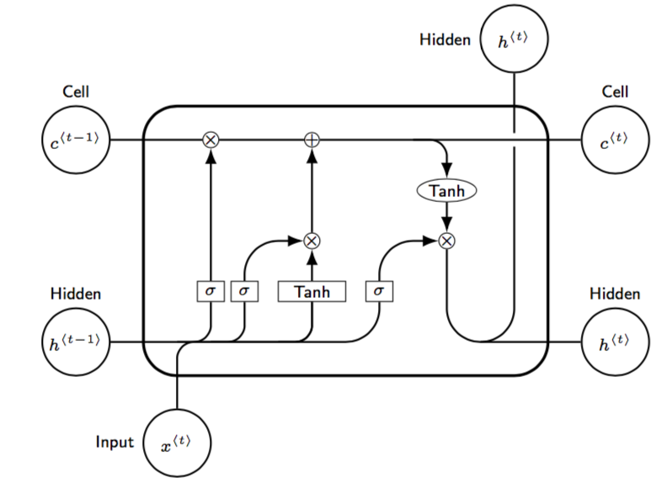
Invoice processing through Beaker deep learning models
Invoice
Sent for review
1
Beaker tabular is a deep neural network that can flag potential errors immediately
It is optimized for precision (90%): we want to avoid false positives
Detects 61% of invoices with issues (recall)
After a week, we run the Beaker NLP model on accumulated emails and call transcripts to catch errors that may have been missed
Precision 66%, recall 49%
Issue?
Yes
1
Beaker Tabular DNN
No
Wait 7 days
2
Issue?
Yes
2
Beaker NLP
No

Slide 8
Implementation
Final model was deployed in August 2018 (FY19-P02)
Savings to date: $20M
Flagged several large invoices that had problems, enabling us to fix errors earlier
Beaker
Day 0-13 Beaker helps us find and fix errors
Day 30 Original Invoice due
Day 43 Average invoice due date with Beaker
Day 81 Average invoice due date without Beaker
Day 0 Invoice issued with 30-day terms
13 days
Delay after Beaker
51 days Delay before Beaker

Slide 9
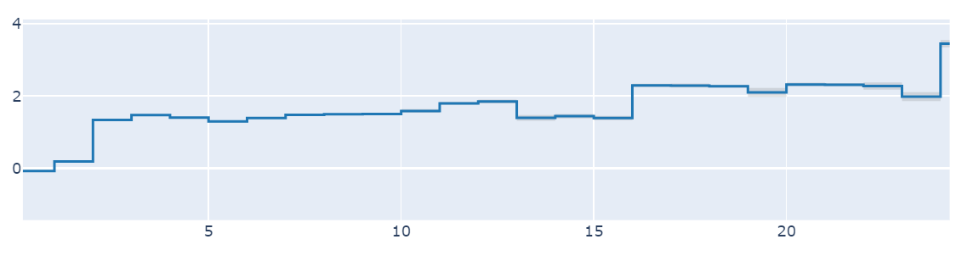
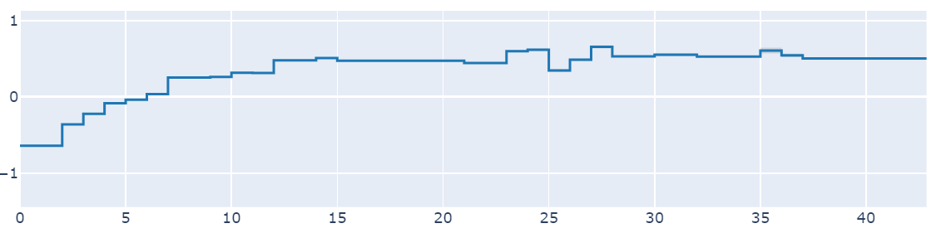
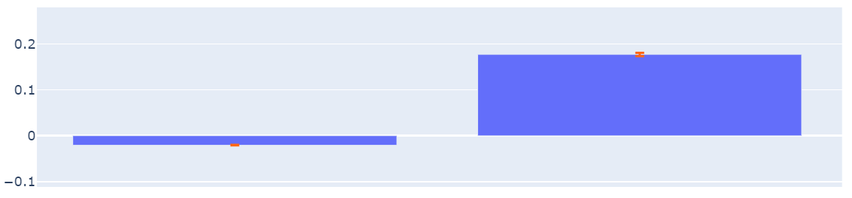
Project Beaker – Insights
We used explainable models to help Operations and Commercial Finance prioritize where to focus when changing credit and rebill processes and policies.
Interpret package from MSR, Samuel Jenkins, Harsha Nori, Paul Koch, and Rich Caruana
Risk score
N
Y
Number of pages
Number of amendments in agreement
Contains Azure
Longer invoices are more likely to have issues
Issues are more likely in invoices for contracts that have complex, non-standard agreements
Volume licensing invoices that contain Azure are more likely to have issues
Since we finished our project, credited invoices are down 40%

Slide 10


Example 1:
Inbound Workgroup Manager

Slide 11







Supply Chain
The problem:
How to get things to customers faster and cheaper.
Some solutions:
More warehouses
More inventory
Some better solutions:
Better forecasting
Efficient transportation
Efficient under the roof
vendor
vendor
inbound shipment
inbound shipment
vendor
transshipment
outbound shipment
fc
vendor
Hub / dc
vendor

Slide 12
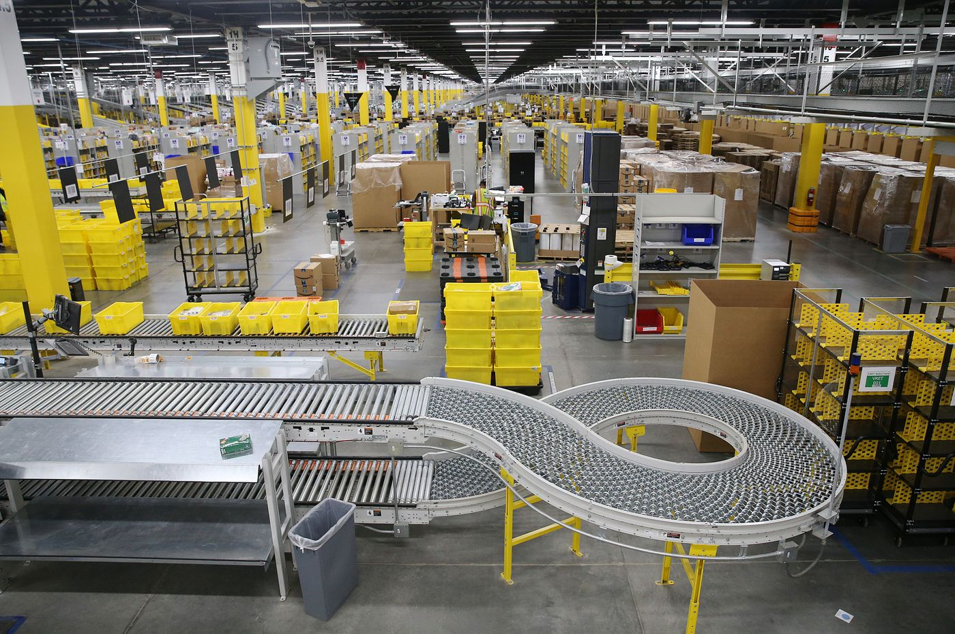
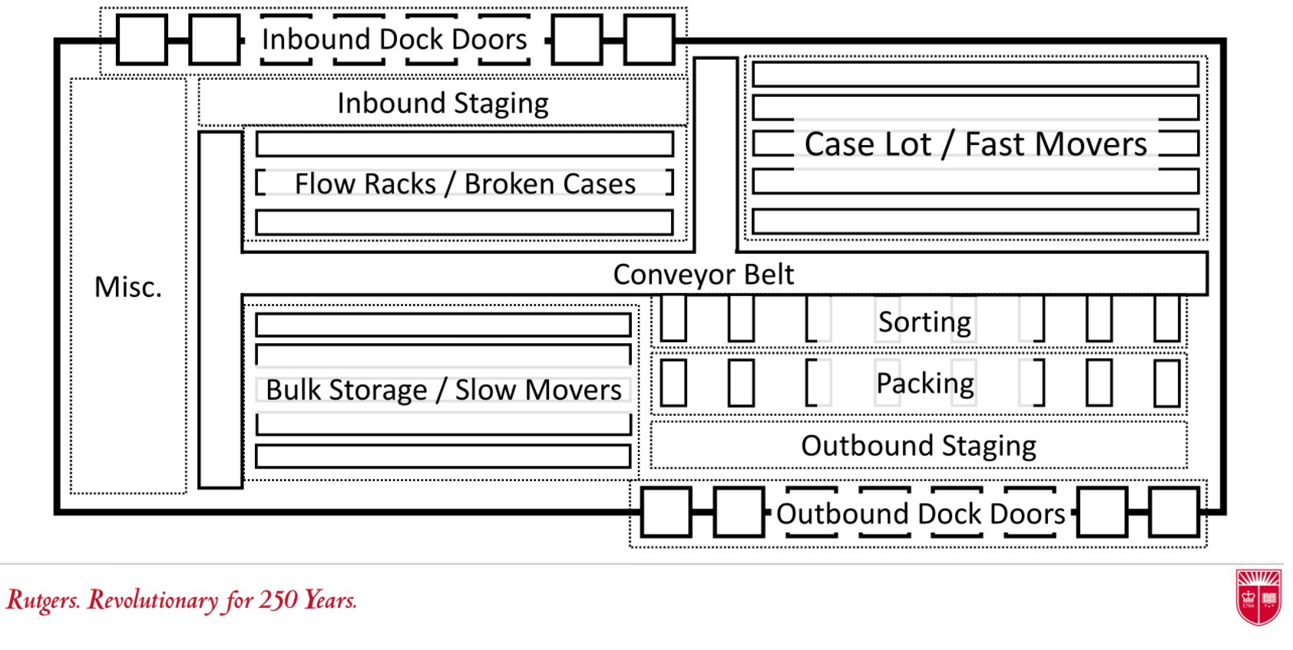
Under the roof

Slide 13
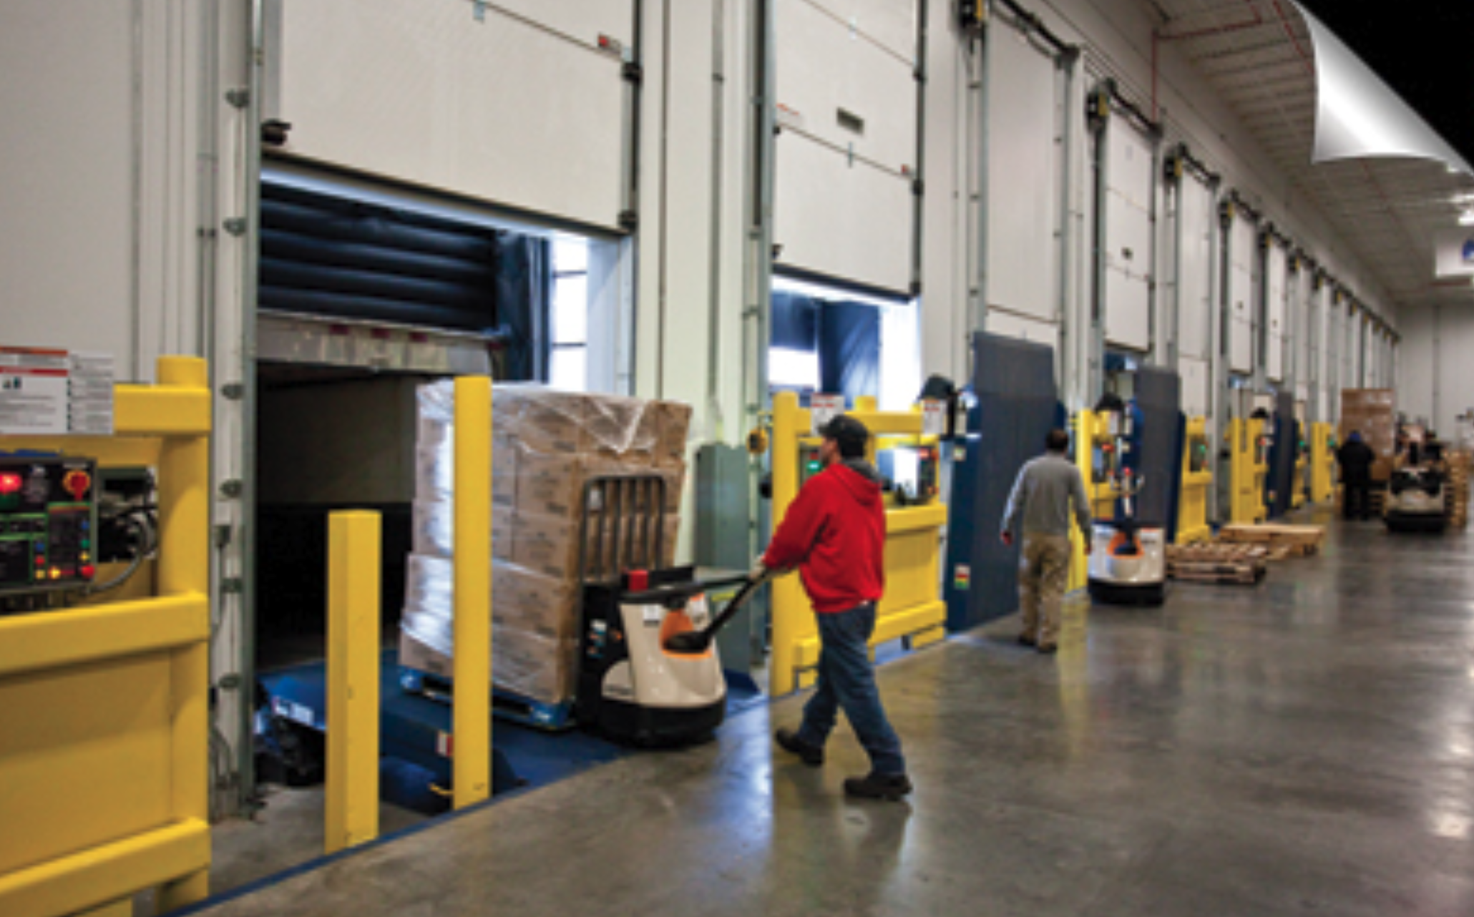

Inbound Workgroup Manager
How many people are needed in the next few hours to unload the trucks as fast as possible?

Slide 14
How many people are needed?
Given the forecasted arrivals and average time to stow, how many HC are required to stow items
without letting them expire?
For example, assuming the average headcount can stow 100 units per hour…
Delivery in | Units | Expires in
0 hours | 800 | 4 hours
Many potential solutions:
8, 0, 0, 0
0, 8, 0, 0
0, 0, 8, 0
…
3, 3, 1, 1
….
2, 2, 2, 2 ← Minimal variance

Slide 15
Example 2
Delivery in | Units | Expires in
0 hours | 800 | 4 hours
2 hours | 800 | 6 hours
Still many potential solutions:
8, 0, 8, 0
0, 8, 8, 0
0, 0, 16, 0
…
Now we have several solutions with the same variance:
3, 3, 3, 3, 2, 2
3, 2, 3, 2, 3, 3

Slide 16
An optimization problem
At this point, you may have realized that we’re solving an optimization problem:
${\text{argmin}}_{H} \sum_{T}{\left(E_{T}−\sum_{t=0}^{T}{R×H_{t}}\right)}+K×\text{Var}\text{(}\text{H}\text{)}$
In summary, “choose the vector H that minimizes expired items and variance”.
Subject to some constraints (equations not provided):
HC limit (no element of H bigger than X)
No negative units:
Can’t remove more units that already arrived
The good news: linear optimizer packages (e.g., Python-MIP, Gurobi, etc.) solve this problem in less than a second

Slide 17
But what about machine learning?
${\text{argmin}}_{H} \sum_{T}{\left(E_{T}−\sum_{t=0}^{T}{R×H_{t}}\right)}+K×\text{Var}\text{(}\text{H}\text{)}$
The most salient opportunity is to focus on estimating arrivals and expirations better
Can also estimate R and transform K to a cost function:
${\text{argmin}}_{H} \sum_{T}{\left(E_{T}−\sum_{t=0}^{T}{R\left(\text{temp}\text{, }\text{absenteeism}\text{,} \text{H}\text{_}\text{tenure}…\right)×H_{t}}\right)}+K\text{(}\text{H}\text{, }\text{time} \text{of} \text{day}\text{, }\text{H}\text{_}\text{tenure}\text{, }\text{Var}…\text{)}$
Now we have to solve two problems simultaneously:
Properly estimating R
Minimizing the cost and expirations

Slide 18
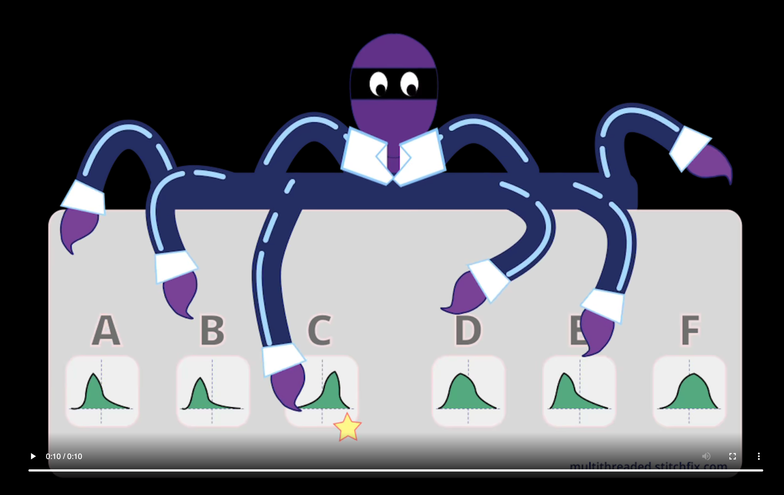
Interlude – Multi-armed bandits
https://multithreaded.stitchfix.com/blog/2020/08/05/bandits/ https://multithreaded.stitchfix.com/assets/posts/2020-08-05-bandits/multi_armed_bandit.webm

Slide 19
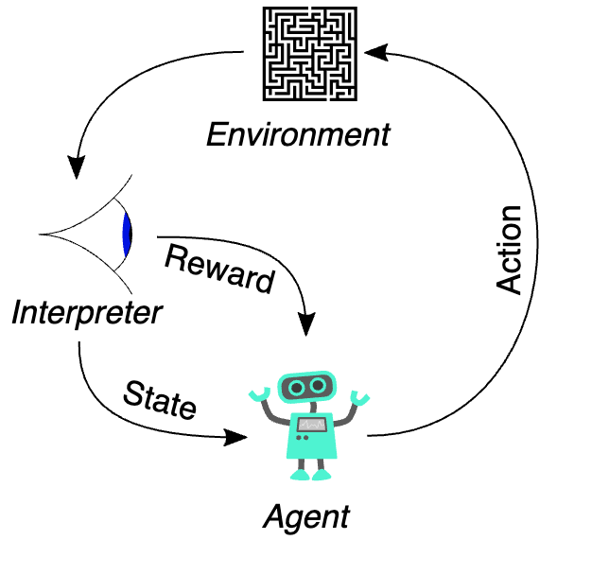
Reinforcement Learning
Arrivals + Expirations + other variables
Use optimizer and past learner to determine optimal or near-optimal solutions
Balance explore vs. exploit
-(E+K)
Change number of HC
Arrivals + Expirations + other variables

Slide 20
Takeaways

Slide 21

In my experience…
The main characteristic of a successful machine learning model are its Economics
A machine learning model is either making/saving money or costing money
If you can show that your model has good Economics, you’ll get plenty of resources

Slide 22

About “weak baselines”
It’s possible that the only reason why the buffer could be reduced by a large amount was because the old forecasting method was bad.
It’s likely that even an unsophisticated model will beat a “weak baseline”.

Slide 23
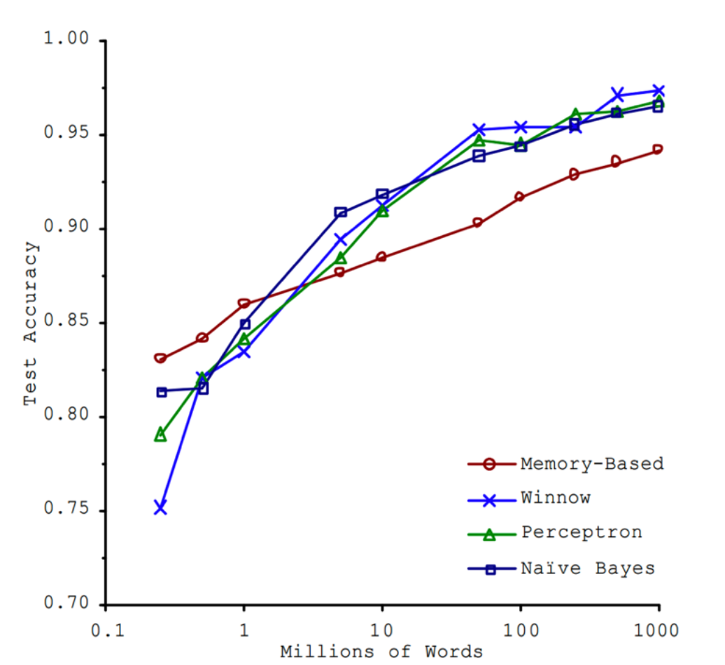
About “the unreasonable effectiveness of data”
The more data you have, the better your project will perform, even if you don’t choose the best algorithm.
The terminology changed over time:
Memory-based: e.g. KNN
Winnow: optimized perceptron
Perceptron: early neural network
Naïve Bayes: you probably know it
Source: Banko, Brill (2001) – Microsoft Research

Slide 24

Choosing successful projects
You have enough data
You know the baseline and think you can beat it
Beating the baseline provides economic value far in excess of the cost of your project

